Slide 1
Bard Hall Materials Facility Safety Orientation Rooms B47, B47A, B47B, B55, B56, SB30, SB56, SB58 Bard Hall
Dr. Mark Pfeifer
map322@cornell.edu
607-255-4161
Kevin Silverstein
kws74@cornell.edu
607-254-3307

Slide 2
Emergency Contact Info
In case of emergency:
Dial 911 from a mobile phone
Use an emergency phone in the hallways or stairwells as marked on the map in the next page
Dial 5-1111 from a campus phone
For non-emergency, urgent equipment issues, call the appropriate staff member using the number posted on the HASP signs on the doors.
In the event you have any further questions regarding the proper procedures, safety regulations, or other concerns, please contact one of the Facility Staff.
You may also find the following contacts may be able to assist you:
Stephanie Ann Pierson: Facilities coordinator
sam265@cornell.edu | 607/255-7767
coecis.cornell.edu/facilities
John Sinnott, CCMR Group Safety Representative
jps39@cornell.edu, 624 Clark Hall

Slide 3
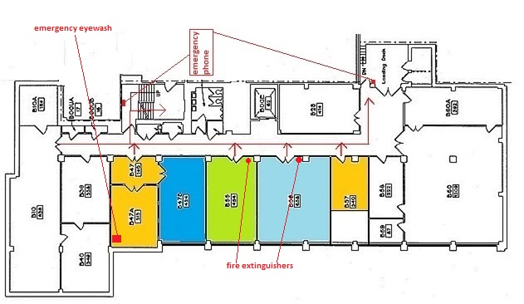
In the event of an emergency, evacuation should be along the route outlined by the red arrows. To report emergencies please use the emergency phones in stairwell or on the loading dock.
Bard Basement CCMR Training and Evacuation Plan
Colored rooms require general trainings for access.
Colored rooms require laser safety training in addition to general safety trainings for access.
Colored rooms require compressed gas training in addition to general safety trainings for access.
Colored rooms require cryogen training in addition to general safety trainings for access.

Slide 4
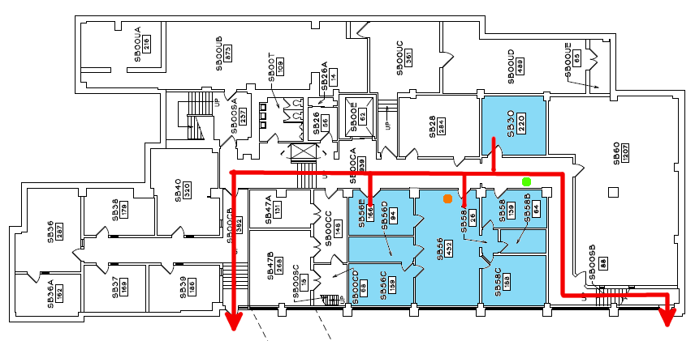
In the event of an emergency, evacuation should be along the route outlined by the red arrows. To report emergencies please use the emergency phones in stairwell or on the loading dock.
Bard Sub-Basement CCMR Training and Evacuation Plan
A fire extinguisher is located just inside the door from the hallway into the SB56 suite.
An emergency shower is located in the hallway outside SB30.

Slide 5
Area-Specific Hazards
In addition to general safety training and equipment-specific safety training outlined on the previous page, all users working in the following areas should be aware of hazards which could potentially impact users not specifically using these systems:
Cryogenic Hazards (B56): Cryogenic liquids are used regularly for cooling components of the Hyperion FTIR Microscope, Vertex Vacuum FTIR, and the Dynamic Mechanical Analyzer. Due to the hazards associated with their use, all users in B56 should be aware when they are in use and observe appropriate safety practices. Wear safety glasses whenever cryogens are in use in the room, and do not touch any surface of a dewar, transfer line, or probe under cooling without cryogloves. If you notice a liquid or gas leak (or anything unusual) and the cryogen user is not present, notify them and/or the facility staff immediately.
Chemical Area (B47A): The fume hood in B47A is available for use on a case by case basis. Consult with a facility manager if you require a fume hood for your project. They will discuss your required chemicals, any concerns that they may have about incompatibles, and proper handling and disposal of wastes. Use and disposal of chemicals should be cleared with the facility staff and an appropriate MSDS should be provided. All containers must be labeled with the contents and the user’s name. Users in B47A not using the fume hood should assume that hazardous chemicals are present in the hood and observe appropriate safety practices. After use, the fume hood should be left down at an appropriate level indicated by the green arrows.
Lasers (B56, SB30): There are Class IIIB lasers in SB30 for the Raman systems—in normal operation these lasers are not entering the room as a direct beam and users are not required to wear laser safety goggles. The Edinburgh FLS-1000 in B56 uses pulsed class 3R/B lasers for fluorescent lifetime measurements.

Slide 6
Area-Specific Hazards (cont.)
In addition to general safety training and equipment-specific safety training outlined on the previous page, all users working in the following areas should be aware of hazards which could potentially impact users not specifically using these systems:
Compressed Gas (B55): The regulators attached to the tanks of compressed gas that are used for the furnaces in B55 should not be changed without seeking permission from the facility staff every time. Compressed gas tanks will be moved and installed by facility staff and not by users.
Radiation Safety (Bard SB56, Clark E1): X-ray diffractometers produce ionizing radiation, with a maximum possible photon energy of 10 keV for the Multiwire Laue diffractometer in Clark E1 and a maximum of 40 keV for the diffractometers in SB56. Each of these instruments includes an interlock which is designed to prevent exposure of users to this radiation. Users of these instruments must be added to the radiation permit.

Slide 7
General trainings required to access the facilities are as follows - EHS #2555 - Laboratory Safety - EHS #2716 - Chemical Waste Disposal - EHS #5330 - Fire Safety In addition to general training, rooms with specific hazards require extra training to access. -Access to rooms SB30, and certain instruments in B56 require EHS #2397 - Laser Safety -Access to room B55 requires EHS #2335 – Compressed Gas Safety -Access to certain instruments in room B56 EHS #3055 – Cryogen Safety -Access to certain instruments in SB56 Bard Hall, and E1 Clark Hall require EHS #5033 – Radiation Producing Equipment Safety Access will only be granted once safety trainings have been verified by the facility manager!
Training required for facility access

Slide 8
Other Facility Guidelines
Equipment Usage - Users are prohibited from using equipment for which they have not been trained. In general, equipment training will be done by facility staff; exceptions require explicit permission from the staff. Visitors or users’ colleagues may OBSERVE use of equipment without completing access/training requirements as long as they follow all necessary safety measures, but may not USE equipment until all requirements are properly completed. Use of equipment which has been enabled under someone else’s FOM account is strictly prohibited in all CCMR facilities. Each tool will have Standard Operating Procedures (SOP) posted at the tool describing:
a. All EH&S safety training required for use
b. All Personal Protective Equipment (PPE) required
c. Equipment-specific training required before use
d. General use procedures and emergency notes
Attire & Personal Protective Equipment (PPE) – All users are expected to wear closed-toed shoes, long pants and shirt sleeves at all times in the lab. Long hair should be tied back to avoid any moving parts. Safety glasses are required for all users in chemical areas and should be worn in all areas when appropriate. Nitrile gloves are available in all areas; if stock of gloves is low or has run out, please notify facility staff.
Food & Drinks – Food and drinks should not be stored or consumed anywhere in the facility.
Other Notes –
Keep all areas as neat and clean as possible.
Cell phones, laptops, etc. may be used as long as use does not distract from appropriate facility use.
Headphones may be used if one ear is left open and cords do not interfere with equipment use or create hazards.
Music is allowed at a reasonable level as long as all users in the lab agree. If asked, it must be turned off.
You should be able to access Red Rover (“eduroam”, “RedRover”, or “RedRover-Secure”) in the facility and surrounding areas.

Slide 9
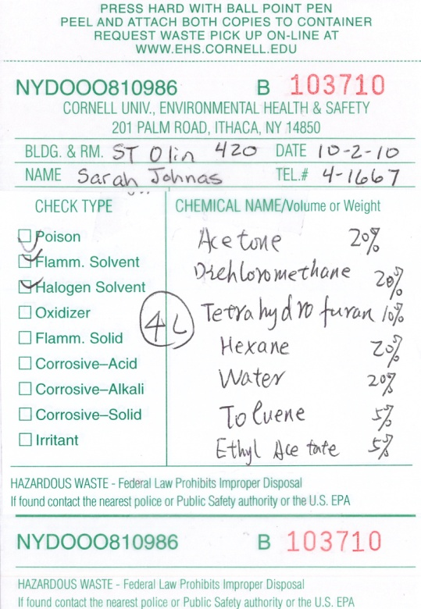
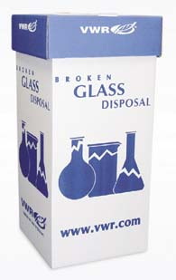
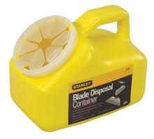
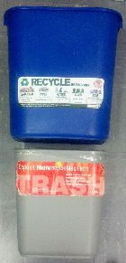
Waste Disposal
All waste in the facility will fall into one the following categories and should be disposed of accordingly:
Hazardous Waste – Bard B47 is the only room in this facility which includes a satellite waste accumulation site, and is restricted to users of that room. In all other rooms, all hazardous materials brought by users must be removed at the end of an experiment.
Noxious Fumes – Before bringing any strong-smelling materials to the lab, discuss your experiment with a laboratory manager. You will be required to keep all materials in sealed containers except during transfer and measurement.
Lab Glass – Microscope slides, old or broken glass labware, silicon wafers, ALL pipettes, and other glass used for scientific purposes which are not contaminated with hazardous materials should be disposed of in the appropriate containers in B56 or SB30.
Sharps – Used blades and other sharp objects (see exceptions below) go in the designated container.
Syringes/needles/pipette tips – These all have special storage/disposal guidelines. Consult with facility staff if you plan to use any of these in the facility.
Recyclables – Paper (excluding used paper towels), cardboard (boxes should be broken down), clean and empty drink containers, and other recyclables should be left in the small blue recycling bins in the individual rooms.
Trash – Anything not fitting the above categories should go in the small trash bins in the individual rooms.
All samples in the facility must be properly labeled and should be removed from the facility after use/analysis. Any unlabeled samples left in the facility may be disposed of by the facility staff at any time.

Slide 10
CCMR Facility Access form
Please go to the link below to download the PDF form which you can provide to the appropriate facility staff.
http://www.ccmr.cornell.edu/ccmraccessform/
Please remember to properly acknowledge use of the CCMR Facilities in your presentations, publications, and conference proceedings

