Slide 1
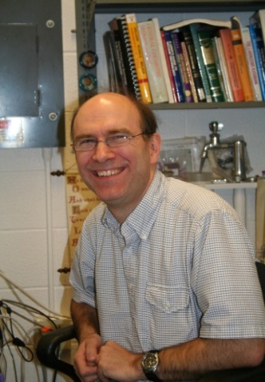
Scanning Electron Microscope Laboratory
F-3 Clark Hall – Safety Orientation
Mick Thomas
mt57@cornell.edu
607-255-0650
Phil Carubia
pmc228@cornell.edu
607-255-6757
Alicia Tripp amt342@cornell.edu
607-255-3608

Slide 2
Acknowledging the facility
Please remember to properly acknowledge use of the CCMR Facilities in your presentations, publications, and conference proceedings. The inclusion of grant numbers in publications is vital for agreements with funding agencies, as publications are searchable (e.g., in Web of Science, Google Scholar).
The CCMR reminds researchers preparing to publish results to consider journal guidelines for determining co-authorship. This generally includes substantial/significant contributions to experiment design, data acquisition, analysis and interpretation.
Determination of co-authorship depends on the contribution of the individual and should be made without regard to position or compensation. All co-authors must approve manuscript versions for publication and agree to be held accountable for the work.

Slide 3
Shared Facility Safety
The Clark Hall SEM Laboratory is a shared facility.
You are responsible for your own safety and the safety of those around you.
Protect yourself: Pay attention to notices and warning signs posted in the facility. Access restrictions, hazards, warnings, and emergency contacts are posted on HASP door signs.
Be conscientious: Don’t take a chance of putting yourself, other facility users, facility staff, or custodians at risk.
Do not introduce hazardous materials without approval from facility staff.

Slide 4
Sample safety
All quantities of all samples, whether in bulk form or mounted must be returned to your lab for disposal. There is no disposal at all of any kind or quantity of material in the SEM lab.
No hazardous samples (such as radioactive material) are allowed in the SEM. If uncertain contact the lab manager.
Samples to be approved by the manager include, but not limited to:
Powder samples or similar “loose” material
Potentially moist samples
Unusual size or shape
Hazardous material

Slide 5
Instrument safety
Equipment training can only be done by facility staff. Untrained users may come and watch the SEM being used by a trained labmate or collaborator, but they must not touch the SEM themselves.
Use of equipment which has been enabled under someone else’s FOM account is strictly prohibited in all CCMR facilities
Both SEMs have Standard Operating Procedures (SOP) posted at the tool and/or on FOM describing proper use and any necessary safety precautions.

Slide 6
Emergency contact
In case of emergency dial 911 from a campus phone, or 607-255-1111 from your mobile phone to reach Cornell Dispatch.
For urgent but non-emergency equipment issues, call the appropriate staff member using the number posted on the HASP signs on the doors. If you have questions regarding proper procedures, safety regulations, or other concerns, please contact one of the Facility Staff:
Mick Thomas: 607-255-0650 mt57@cornell.edu
Phil Carubia: 607-255-6757 pmc228@cornell.edu
The following contacts may also be of assistance:
John Sinnott, CCMR Safety Representative: jps39@cornell.edu, 624 Clark Hall
Todd Pfeiffer, PSC Facilities Director: tap66@cornell.edu, E22 Clark Hall

Slide 7
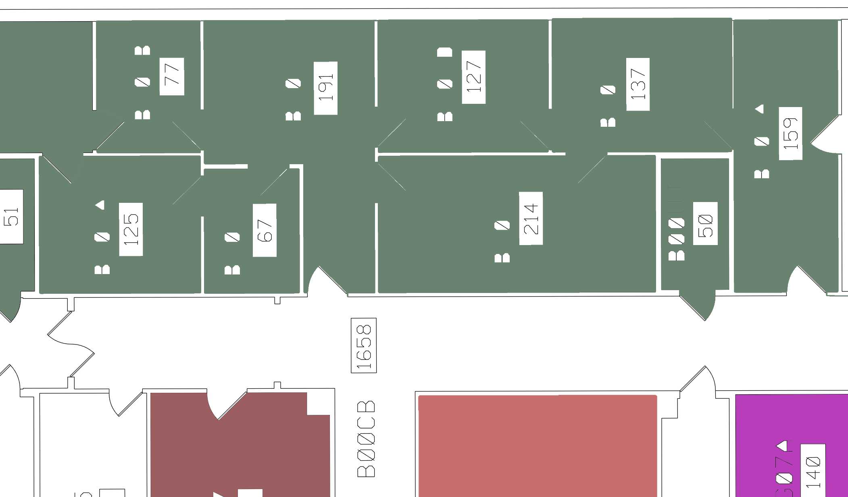
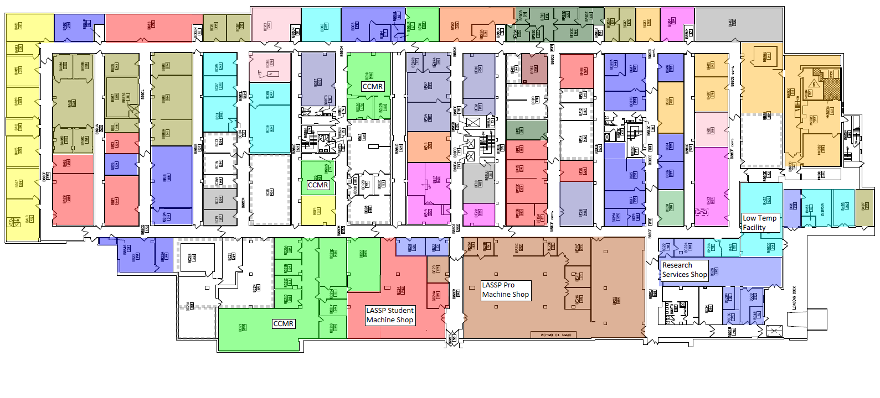
Gemini SEM
Emergency exits:
Gemini
SEM
In case of an emergency, follow the exit signs to the loading dock (primary exit), or use indicated stairs (secondary exit) or go to PSB (only if no other escape exists). Do not use elevators!
Keck
SEM
Keck SEM
Stairway
Stairway
Stairway
Loading dock
PSB

Slide 8
Shared Facility Access
All users must understand the information presented in this facility orientation and show proof of the following safety trainings, available through Workday Learning, in order to gain access to the facility:
EH&S Laboratory Safety (#2555-laboratory)
EH&S Chemical Waste Disposal (#2716-chemwaste)
EH&S Fire Safety (#5330-firesafety)
See http://workday.cornell.edu/ for information on how to obtain training or verify your records

Slide 9
CCMR Facility Access Form
Please go to the link below to download the pdf form which you can provide to the appropriate facility staff
http://www.ccmr.cornell.edu/ccmraccessform/

