Slide 1
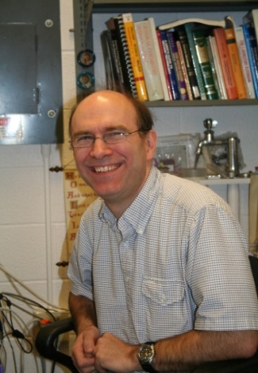
Sample preparation Laboratory
231 Duffield Hall – Safety Orientation
John Grazul
STEM manager
jlg98@cornell.edu
607-592-8989
Phil Carubia
STEM manager
pmc228@cornell.edu
607-255-6757
Mick Thomas
FIB manager
mt57@cornell.edu
607-255-0650

Slide 2
Acknowledging the facility
Please remember to properly acknowledge use of the CCMR Facilities in your presentations, publications, and conference proceedings. The inclusion of grant numbers in publications is vital for agreements with funding agencies, as publications are searchable (e.g., in Web of Science, Google Scholar).
The CCMR reminds researchers preparing to publish results to consider journal guidelines for determining co-authorship. This generally includes substantial/significant contributions to experiment design, data acquisition, analysis and interpretation.
Determination of co-authorship depends on the contribution of the individual and should be made without regard to position or compensation. All co-authors must approve manuscript versions for publication and agree to be held accountable for the work.

Slide 3
Shared Facility Safety
The Duffield Hall Electron Microscope Laboratory is a shared facility.
You are responsible for your own safety and the safety of those around you.
The safety rules for CCMR are based on our best interpretation of requirements at the federal, local, campus, and Duffield Hall levels. As a core facility with a broad user base, our goal is to enable all users to have the safest and most efficient possible research experience.
In the event you have any further questions regarding the proper procedures, safety regulations, or other concerns, please contact one of the Facility Staff. You may also find the following contacts may be able to assist you:
Protect yourself: Pay attention to notices and warning signs posted in the facility. Access restrictions, hazards, warnings, and emergency contacts are posted on HASP door signs.
Be conscientious: Don’t take a chance of putting yourself, other facility users, facility staff, or custodians at risk.
Do not introduce hazardous materials without approval from facility staff.

Slide 4
Sample safety
All quantities of all samples, whether in bulk form or mounted must be returned to your lab for disposal. There is no disposal at all of any kind or quantity of material in the Specimen Preparation Laboratory.
Samples that are new to the preparation room must first be approved by the facility manager.

Slide 5
Instrument safety
Equipment training can only be done by facility staff. Untrained users must take all the safety courses listed in this manual and then they can come and watch the instruments being used by a trained lab mate or collaborator, but they must not touch the instruments or chemicals themselves.
Use of equipment which has been enabled under someone else’s FOM account is strictly prohibited in all CCMR facilities
All instruments have Standard Operating Procedures (SOP) posted at the tool and/or on FOM describing proper use and any necessary safety precautions.

Slide 6
Emergency contact
In case of emergency dial 911 from a campus phone, or 607-255-1111 from your mobile phone to reach Cornell Dispatch.
For urgent but non-emergency equipment issues, call the appropriate staff member using the number posted on the HASP signs on the doors. If you have questions regarding proper procedures, safety regulations, or other concerns, please contact one of the Facility Staff:
John Grazul: 607-592-8989 jlg98@cornell.edu
Phil Carubia: 607-255-6757 pmc228@cornell.edu
Mick Thomas: 607-255-0650 mt57@cornell.edu
The following contacts may also be of assistance:
Scott Albrecht sja4@cornell.edu (major emergency only such as a flood)

Slide 7
CCMR Prep Lab Training
231 Duffield Hall: All users must understand the information presented in this facility orientation and show proof of the following safety trainings, available through Workday Learning in order to gain access to the preparation laboratory
See this page for information on how to obtain training or verify your CULearn information.
EH&S Laboratory Safety (#2555-laboratory)
EH&S Chemical Waste Disposal (#2716-chemwaste)
EH&S Fire Safety (#5330-firesafety)
EH&S Cryogen Safety (#3055)
CCMR safety course unique to room 231
See http://workday.cornell.edu/ for information on how to obtain training or verify your records

Slide 8
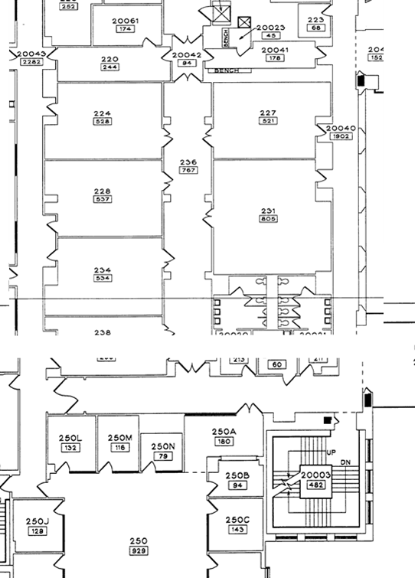
Preparation room safety
To Main North Entrance
Leave room 231 and turn either left or right to reach safety
IF THERE IS A FIRE ALARM OR A GAS ALARM – EVACUATE THE BUILDING.
Leave your experiments in safe condition
covered chemicals, instrument on standby, etc.
CCMR TEM Prep Lab
.
To Atrium

Slide 9
Preparation room safety
EH&S – 911 PHONE (red colored phones) If you accidentally lift up the phone, stay on the line and explain what happened so they know it is a false alarm. Regardless, police and EH&S will respond to any call no matter what!
911 phones and fire alarm pull boxes are located next to the fire exits
EMERGENCY PHONE
CCMR TEM Prep Lab
FIRE EXTINGUISHER
SAFETY SHOWER
EYE WASH
THERE ARE ADDITIONAL FIRE EXTINGUISHERS IN THE CENTRAL CORRIDOR BUT THESE ARE A DIFFERENT CLASS THAN THE ONES IN THE GENERAL CORRIDOR – IF YOU DON’T KNOW HOW TO USE ANY OF THEM - DON’T !
If you start a fire alarm or call on EH&S/Fire department, meet them at the main north entrance and explain the situation.

Slide 10
Transporting materials to 231
LIQUID SAMPLES
Less than 50 ml aqueous buffers and less than10 ml organic solutions
BIOLOGICAL SAMPLES
Notify staff before bringing a new sample in for the first time.
MSDS sheet must be on record.
Samples can be transported into the CCMR labs via the shortest route (see arrows). Samples should be transported in a primary container (falcon tubes, glass scintillation vials, etc.), which in turn is kept in a secondary container (tool box etc.)
CHEMICALS
Notify staff when you want to bring chemicals into the labs
Make an appointment with staff beforehand to meet the staff member with your chemicals at the Phillips Hall loading dock (where the big liquid N2 tanks are).
All bottles must be labeled by staff
You will need to provide an MSDS sheet (.pdf format)
Email to jlg98@cornell.edu
Order the approved chemical Shipped directly to CCMR, attention John Grazul. Send an Email to jlg98@cornell.edu alerting us to expect an incoming package.
Bring chemicals in through the service corridor only (blue arrow)
CCMR TEM Prep Lab
No chemicals allowed along the routes in red

Slide 11
Entering CCMR room 231
Enter the labs by swiping your ID card at the door
Every user must swipe their ID every time when entering the CCMR labs!
SAFETY EQUIPMENT REQUIRED
Personal safety equipment is located near the entry door
Safety glasses required at all times
Lab aprons required while using wet chemicals
Dispose of gloves when you remove them, they are disposable for a reason
APPROPRIATE DRESS REQUIRED
NO headphones allowed in the labs
NO shorts, short pants, skirts with bare legs, sandals, open-toed shoes, midriff-baring tops, shoes that expose the tops of the feet, etc.
Lab visitors are responsible for adhering to these same rules regarding lab conduct and safety and must be accompanied by a registered Facility user at all times!

Slide 12
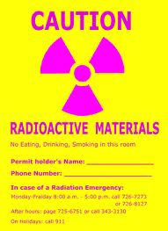
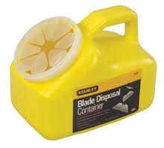
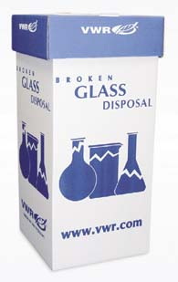
CCMR Preparation Lab – Waste and Trash
BROKEN GLASS ONLY! No biological material
ANYTHING THAT CAN PUNCTURE A GARBAGE BAG MUST GO INTO A SHARPS CONTAINER (PIPET TIPS RAZORS ETC..)
Uranyl Acetate Waste
GENERAL TRASH
Paper, gloves etc. No biological material No sharps!
12

Slide 13
CCMR Preparation Lab – Chemicals
If you use any hazardous/corrosive chemicals use an apron/lab coat.
Always have the fume hood sash in the proper working position.
Use solvents in the solvent hood and acid/bases in the corrosive hood.
If you must use acids/bases and organic solvent together, use the most appropriate hood (depending on the type of hazard).
Osmium Tetroxide, and Ruthenium Tetroxide are ONLY to be used by trained users in the appropriately labeled hood. You are required inform other users in the lab when you are using these chemicals
All chemicals must be properly labeled with the chemical name, date and your name. Chemicals not labeled will be disposed of without notice
MSDS sheets are on each desktop along with the chemical hygiene plan and a list of chemicals

Slide 14
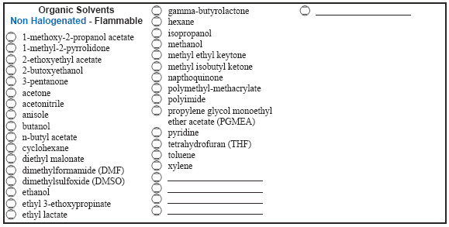
CCMR Preparation Lab – Chemical Waste
Organic Solvents
There are labeled waste containers in the fume hoods. The bottles have a specific label for each classification of solvent
Acids and Bases
Put ANY acid or base waste into the appropriate waste container (found under the hood).
Other waste chemicals
If there is a need to collect a specific type of chemical that cannot be discarded in any existing waste bottle, please notify staff and we will make a waste bottle for that class of chemical.
MSDS sheets and the lab safety manual are located on each lab computer
For all waste:
Fill the bottles to ~ the marked line, when filled to this level put them in the back of the hood in the spill containment box
When a bottle is full to the line, let the facility manager know as soon as possible.

Slide 15
CCMR Facility Access Form
Please go to the link below to download the pdf form which you can provide to the appropriate facility staff
http://www.ccmr.cornell.edu/ccmraccessform/

