Slide 1


Clark Hall Materials Facility
Safety Orientation
For rooms D21, D19, D15, D10, D22, E1 Clark Hall
Steve Kriske
kriske@cornell.edu
607-255-2367
Alicia Tripp
amt342@cornell.edu
607-255-3608
Facility Manager: Jon Shu (jbs24@cornell.edu)

Slide 2

Acknowledging the Facility
Please remember to properly acknowledge use of the CCMR Facilities in your presentations, publications, and conference proceedings. The inclusion of grant numbers in publications is vital for agreements with funding agencies, as publications are searchable (e.g., in Web of Science, Google Scholar).
The CCMR reminds researchers preparing to publish results to consider journal guidelines for determining co-authorship. This generally includes substantial/significant contributions to experiment design, data acquisition, analysis and interpretation. Determination of co-authorship depends on the contribution of the individual and should be made without regard to position or compensation. All co-authors must approve manuscript versions for publication, and agree to be held accountable for the work.
  CCMR Facilities and support Please refer to the website for most current acknowledgement wording
  MPMS-3 work
  “This work made use of a Quantum Design MPMS-3 supported by NSF (DMR-1920086).”
Clark Hall Materials Facility Safety Orientation

Slide 3
Shared Facility Safety
  The Clark Hall Materials Facility is a shared facility.
  You are responsible for your own safety and the safety of those around you.
  Protect yourself: Pay attention to notices and warning signs posted in the facility. Access restrictions, hazards, warnings, and emergency contacts are posted on HASP door signs.
  Be conscientious: Don’t take a chance of putting yourself, other facility users, facility staff, or custodians at risk.
  Do not introduce new hazards or hazardous materials without approval from facility staff.
Clark Hall Materials Facility Safety Orientation

Slide 4
Shared Facility Safety:
Sample and Waste Management
  All materials and containers must be labeled with the contents, NetID/email, and the date. CCMR provides self-adhesive labels (clipboard near D21 entrance).
  You must get facility staff approval for any activity that may generate hazardous waste.
  All samples must be removed from the facility after use/analysis. Do not leave samples in this facility.
Clark Hall Materials Facility Safety Orientation

Slide 5
Equipment Use
  Equipment training will be done by facility staff.
  Users are prohibited from using equipment for which they have not been trained.
  Use of equipment which has been enabled under someone else’s FOM account is strictly prohibited in all CCMR facilities.
  Each tool has Standard Operating Procedures (SOP) posted at the tool and/or on FOM describing proper use and any necessary safety precautions.
Clark Hall Materials Facility Safety Orientation

Slide 6
Shared Facility Hazards (pg.1)
  All users working in the following areas must be trained and aware of hazards which could potentially impact users in the vicinity. Obey posted signage.
  Chemical Area & fume hood (D21E)
  Fume hood safety training (#3355-FumeHood) is required to work in the fume hood.
  Be aware of hazards and warnings posted on the HASP door signs.
  Safety glasses with side shields are required at all times.
  All containers must be labeled with the contents, NetID/email, and date.
  Safety Data Sheets are required to handle hazardous materials.
  Any activity that may generate hazardous waste requires approval from facility staff.
  There is a shared hazardous waste bottle for non-halogenated organic solvents in the hood. All waste must be documented on the log sheet for the hazardous waste container.
  Do not leave samples in the facility. Take your samples with you when you leave.
Clark Hall Materials Facility Safety Orientation

Slide 7
Shared Facility Hazards (pg.2)
  All users working in the following areas must be trained and aware of hazards which could potentially impact users in the vicinity. Obey posted signage.
  High Magnetic Fields (D19, D21, D22):
  Magnetic Field Safety (#5035-magnetic) training is required to work with equipment in these areas.
  The PPMS systems in D21 and D22 and the MPMS in D19 each contain powerful electromagnets.
  Areas are marked with tape indicating the threshold of a 5 Gauss (5 Oersted) field when the magnet is being operated at full power. (Note – MPMS 5 Gauss “line” is within instrument cabinet.) Users with pacemakers or magnetic surgical implants must stay outside of this area.
Clark Hall Materials Facility Safety Orientation

Slide 8
Shared Facility Hazards (pg.3)
  All users working in the following areas must be trained and aware of hazards which could potentially impact users in the vicinity. Obey posted signage.
  Cryogenic Hazards (D21E, D22, D10):
  Training in Handling Cryogens (#3055-cryogensfty) is required to work with certain equipment in these areas.
  Wear safety glasses whenever open cryogens are in use in the room.
  Do not touch any surface of a dewar, transfer line, or probe under cooling without cryogen gloves.
  If you notice a liquid or gas leak (or anything else unusual), notify the cryogen user and/or facility staff immediately.
Clark Hall Materials Facility Safety Orientation

Slide 9
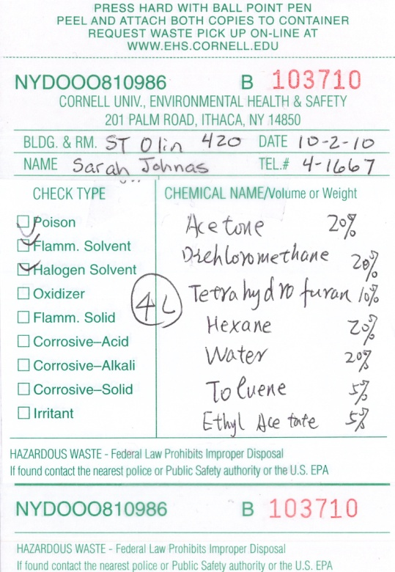
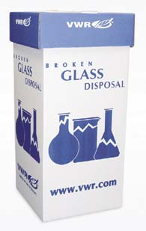
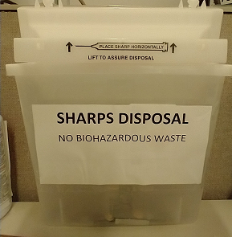
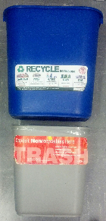
Waste Disposal (pg.1)
  All waste generated in the facility must be disposed of according to EH&S regulations as outlined in EH&S Chemical Waste Disposal training. If you are unsure how to safely dispose of something, please ask facility staff. Don’t take a chance of putting yourself, facility users, facility staff, or custodians at risk.
  Hazardous Waste
    Any activity that may generate hazardous waste must be planned and approved in advance by facility staff.
    Hazardous waste must be collected in the room where it is generated.
    CCMR provides hazardous waste containers bearing an EH&S hazardous waste label.
    Hazardous waste containers must be stored in secondary containment.
    The solvent waste container in the hood has a log sheet. Chemicals and quantities must be added to the log sheet for the container.
    If you need to dispose of a chemical that does not already appear on the container’s hazardous waste label, you must consult with facility staff to determine how your waste should be segregated.
Clark Hall Materials Facility Safety Orientation

Slide 10
Waste Disposal (pg.2)
  All waste generated in the facility should be disposed of according to EH&S regulations as outlined in EH&S Chemical Waste Disposal training. If you are unsure of how to safely dispose of something, please ask facility staff. Don’t take a chance of putting yourself, facility users, facility staff, or custodians at risk.
  Lab Glass – Microscope slides, old or broken glassware, silicon wafers, etc., which are not contaminated with hazardous materials should be disposed of in the glass disposal containers in D21 (outside the office) and D21E.
  Sharps – Used blades and other sharp objects (including small items listed above) go in the white sharps containers located around the lab.
  Pipette tips – Ensure pipette tips are empty, then dispose of them in the white bin in the hood.
  Syringes/needles – Consult with facility staff if you plan to use these as they have special storage/disposal guidelines.
  Recyclables – Paper and cardboard should be left in the small blue recycling bins or the large blue box in D21. (Please note that this no longer includes empty drink containers, etc. in lab spaces.)
  Trash – Anything not fitting the above categories should go in the small trash bins or the large trash can in D21.

Slide 11
Materials Facility Emergency Contact Info
In case of emergency, dial 911 from a campus phone, or 607-255-1111 from your mobile phone, to reach Cornell Dispatch.
For urgent but non-emergency equipment issues, call the appropriate staff member using the number posted on the HASP signs on the doors. If you have questions regarding proper procedures, safety regulations, or other concerns, please contact one of the Facility Staff:
Steve Kriske: kriske@cornell.edu, D21F Clark Hall
Alicia Tripp: amt342@cornell.edu, D21F Clark Hall
Jon Shu (CCMR Associate Director): jbs24@cornell.edu, 633 Clark Hall
The following contacts may also be of assistance:
John Sinnott, CCMR Safety Representative: jps39@cornell.edu, 624 Clark Hall
Todd Pfeiffer, PSC Facilities Director: tap66@cornell.edu, E22 Clark Hall
Clark Hall Materials Facility Safety Orientation

Slide 12
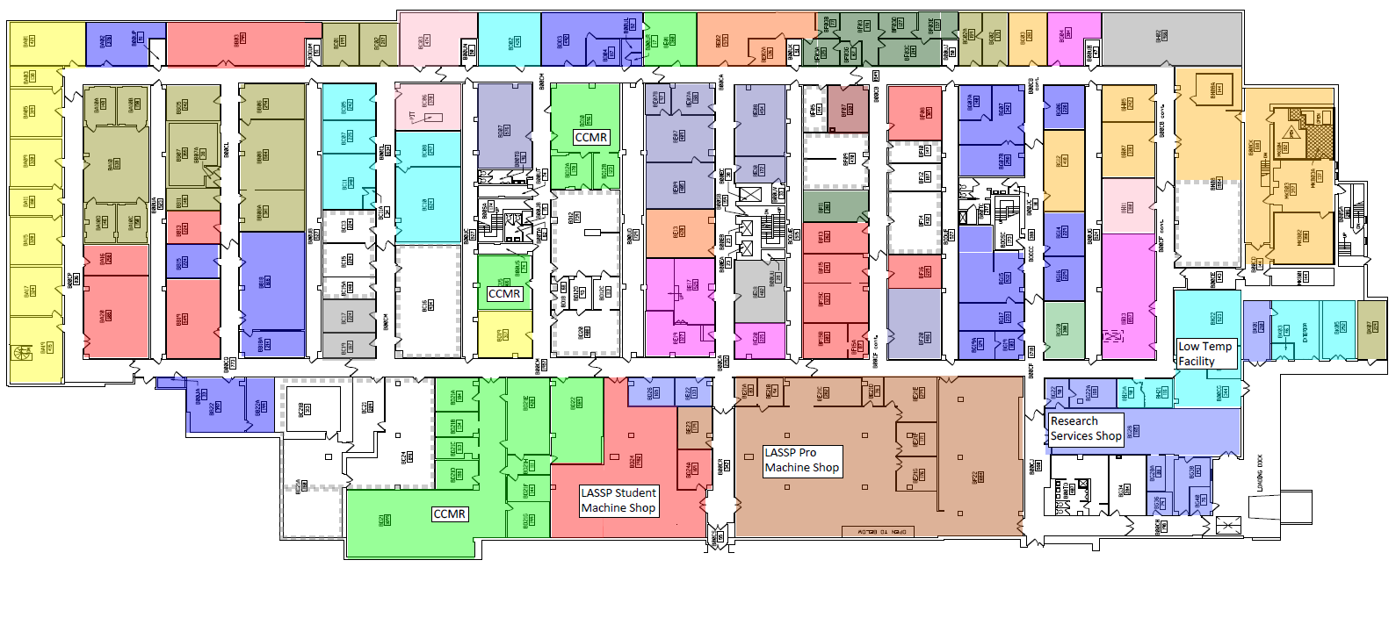
Emergency Exits
In case of an emergency, follow the exit signs to the loading dock (primary exit), or into Baker to the exit at the end of the hallway (secondary exit).
Secondary Exit
Through Baker Hall
Primary Exit to Loading Dock
Clark Hall Materials Facility Safety Orientation

Slide 13
Emergency Facilities
Protect yourself: know where emergency facilities are located before you need them:
Fire Extinguisher
Safety Shower
Eyewash
D19
Clark Hall Materials Facility Safety Orientation

Slide 14
Shared Facility Access
  All users must understand the information presented in this facility orientation and show proof of the following safety trainings, available through Workday Learning, in order to gain access to the facility:
  EH&S Laboratory Safety (#2555-laboratory)
  EH&S Chemical Waste Disposal (#2716-chemwaste)
  EH&S Fire Safety (#5330-firesafety)
  See http://workday.cornell.edu/ for information on how to obtain training or verify your records.

Slide 15
CCMR Facility Access form
Please go to the link below to download the PDF form which you can provide to the appropriate facility staff.
http://www.ccmr.cornell.edu/ccmraccessform/

