Slide 1
Physical Sciences Building (PSB) Electron Microscopy Facility Safety Orientation
Mariena Silvestry Ramos
ms3289@cornell.edu
607-255-6272
Philip Carubia
pmc228@cornell.edu
607-255-6757
Mick Thomas
mt57@cornell.edu
607-255-0650
For Rooms: B95, B91, B71, and B05
Facility Manager: Malcolm Thomas (mt57@cornell.edu)

Slide 2
Acknowledging the Facility
Please remember to properly acknowledge use of the CCMR Facilities in your presentations, publications, and conference proceedings. The inclusion of grant numbers in publications is vital for agreements with funding agencies, as publications are searchable (e.g., in Web of Science, Google Scholar).
The CCMR reminds researchers preparing to publish results to consider journal guidelines for determining co-authorship. This generally includes substantial/significant contributions to experiment design, data acquisition, analysis and interpretation. Determination of co-authorship depends on the contribution of the individual and should be made without regard to position or compensation. All co-authors must approve manuscript versions for publication, and agree to be held accountable for the work.
CCMR Facilities and support: Please refer to the website for most current acknowledgement wording
Titan Themis (Cryo-S/TEM) TEM/STEM work: “The FEI Titan Themis 300 was acquired through NSF-MRI-1429155, with additional support from Cornell University, the Weill Institute and the Kavli Institute at Cornell.”
CRYO-FIB/SEM work: “Support for the FIB/SEM cryo-stage and transfer system was provided by the Kavli Institute at Cornell and the Energy Materials Center at Cornell, DOE EFRC BES (DE-SC0001086).”
Thermo Fisher F200Ci TEM work: “This work relied on data collected using an instrument supported by the NIH through award S10OD030470.”

Slide 3
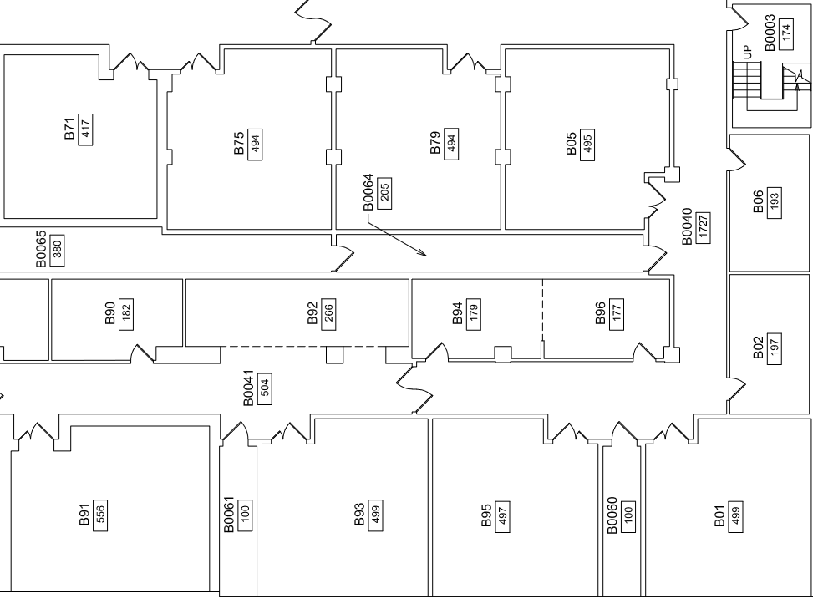
Emergency Exits and Evacuation
In the event of a building evacuation alarm or other emergency, immediately proceed to the nearest exit as outlined by the arrows on the map.
To report an emergency call 607-255-1111 or 911.
Contact the instrument manager to report tool related emergencies.

Slide 4
Shared Facility Access
CCMR facilities require that all users must understand the information presented in this facility orientation and show proof of the following safety trainings, available through Workday Learning, in order to gain access to the facility:
EH&S Laboratory Safety (#2555-laboratory)
EH&S Chemical Waste Disposal (#2716-chemwaste)
EH&S Fire Safety (#5330-firesafety)
In addition, room/instrument specific trainings may be required. For specifics, see the CCMR facility access form at: http://www.ccmr.cornell.edu/ccmraccessform/
See http://workday.cornell.edu/ for information on how to obtain training or verify your records.

Slide 5
PSB EM Facility Specific Rules
External hard drives are forbidden on all Cornell electron microscopes.
No wet chemistry is allowed in the lab.
Do not bring hazardous samples or materials into the lab without prior consent/approval by the Facility Managers.
This is not a storage facility - you must take specimens when you leave. Anything leftover will be promptly discarded.
No food or drink allowed in the lab
Wear proper PPE and follow safety rules when handling liquid nitrogen (pants/jeans regardless of outside weather, shirt covering the shoulders, and closed-toe shoes) .
Failure to follow the rules can lead to a loss of access to the EM facilities.

Slide 6
Instrument Reservation Rules
Instrument reservations can be made via FOM at www.fom.ccmr.cornell.edu
Specialty holder use MUST be logged in the holder google doc at the time that the instrument is booked and updated at the time of use.
All issues that arise during a session must be reported to a facility manager. If we don’t know about it, we can’t fix it.
To keep up to date with instrument issues, updates and downtime, please enable notification by email in FOM.

Slide 7
CCMR Facility Access form
Please go to the link below to download the PDF form which you can provide to the appropriate facility staff.
http://www.ccmr.cornell.edu/ccmraccessform/

