Slide 1
Soft Matter/Polymer Characterization Facility
165 S. T. Olin Laboratory – Safety Orientation
Dimitrios Koumoulis
dk799@cornell.edu
607-255-9021

Slide 2
Acknowledging the facility
Please remember to properly acknowledge use of the CCMR Facilities in your presentations, publications, and conference proceedings. The inclusion of grant numbers in publications is vital for agreements with funding agencies, as publications are searchable (e.g., in Web of Science, Google Scholar).
The CCMR reminds researchers preparing to publish results to consider journal guidelines for determining co-authorship. This generally includes substantial/significant contributions to experiment design, data acquisition, analysis and interpretation.
Determination of co-authorship depends on the contribution of the individual and should be made without regard to position or compensation. All co-authors must approve manuscript versions for publication and agree to be held accountable for the work.

Slide 3
Emergency Contacts
In the event of an emergency, first contact 9-1-1 immediately if there are any injuries. Contact Environmental Health and Safety for chemical hazards.
Inform the Facility Manager or Support Staff immediately regarding any accidents or injuries, as a report will need to be documented.
Environmental Health and Safety, (5-8200, dehs-mailbox@cornell.edu) Dimitrios Koumoulis (5-9021, dk799@cornell.edu), Facility Manager Alicia Tripp (5-3608, amt342@cornell.edu), Research Associate Keane Leitch (5-8773, kjl44@cornell.edu), Physical Sciences Complex Safety Officer Adam Lalonde (5-7309, al268@cornell.edu), S. T. Olin Laboratory Building Coordinator

Slide 4
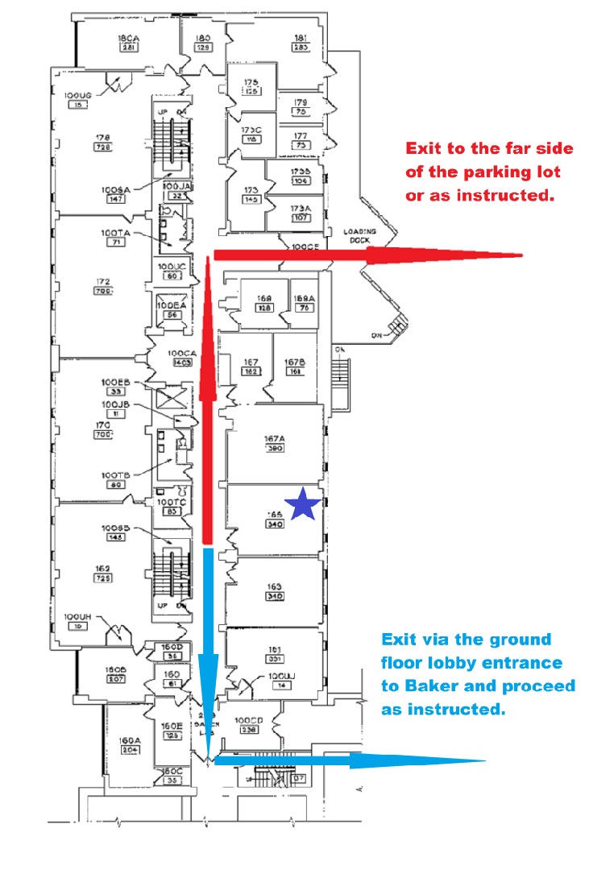
Emergency Exits
Polymer Characterization Facility
In case of a fire or other emergency, indicated by the sounding of the building alarm, you MUST exit the lab and the building immediately. Two potentially available exits are shown on the map to the left.

Slide 5
Emergency Equipment
Lab safety equipment and emergency action devices (emergency phones, building alarm pull-box) are located on the map to the left.
Polymer Characterization Facility
Eye-Wash, Safety Shower, First-Aid Kit, Fire Extinguisher, Spill Kit
Fire Alarm Pull Box
Emergency Phone

Slide 6
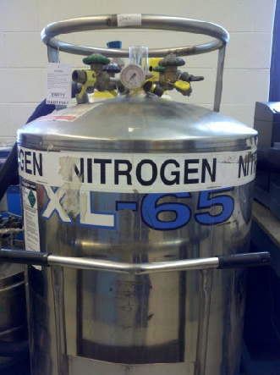
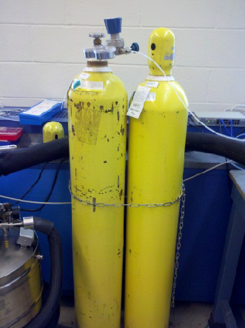
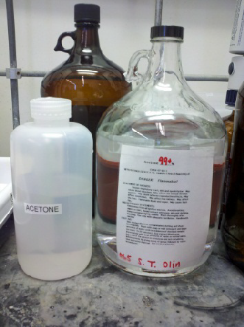
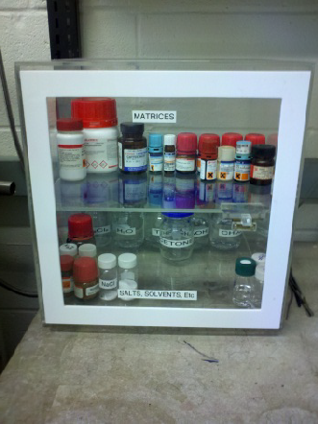
General Laboratory Hazards
Cryogenic Liquid (Nitrogen)
Compressed Gases (Air, Carbon Dioxide)
Flammable Liquids (Organic Solvents)
Chemical Irritants

Slide 7
EH&S Lab Safety Courses
The following laboratory safety courses, offered on-line or in the classroom by Cornell University EH&S, are required to access the Polymer Characterization Facility. EH&S course numbers follow in parentheses for your reference.
EH&S Laboratory Safety (#2555-laboratory)
EH&S Chemical Waste Disposal (#2716-chemwaste)
EH&S Fire Safety (#5330-firesafety)
Other training courses may be required for your individual research laboratories, or as dictated by your Group Safety Representative (GSR), Principal Investigator (PI), or your Department. Please consult with them for any additional requirements or suggestions.
Visit http://www.ehs.cornell.edu for more information.
See http://workday.cornell.edu/ for information on how to obtain training or verify your records

Slide 8
Personal Protective Equipment
Appropriate dress is required AT ALL TIMES when working in the Facility..
No shorts, short pants, skirts with bare legs, sandals, open-toed shoes, midriff-baring tops, tank tops, etc.
Long hair must be tied up and secured.
Lab gloves and safety glasses (provided) must be worn AT ALL TIMES while working in the Facility. NO EXCEPTIONS! Flame-retardant lab coats are highly recommended.
Contaminated gloves must be removed AFTER handling solvents and chemicals, but BEFORE using communal equipment like computer keyboards and mice. NO EXCEPTIONS!
Lab visitors are responsible for adhering to these same rules regarding lab conduct and safety and must be accompanied by a registered Facility user at all times!

Slide 9
Working in the Facility
Please do not wear headphones while working. It may limit your ability to hear in the case of an emergency.
A HASP sign is provided outside of the laboratory door with the appropriate contacts and staff phone numbers.
After appropriate measures are taken to ensure the health and safety of the lab workers, you must contact the Facility Staff in the event of any emergency.
All of the labels and containers you bring into the Facility must be labeled in some fashion.
Name, Date, Chemical NAME (not abbreviation), concentration (if appropriate)
Unlabeled chemicals will be disposed of without notice.
Please clean up after yourself when you are finished working!
Only bring your own research samples or chemicals into the Facility.
Inventoried chemical supplies must be barcoded.
Research samples must be clearly labeled such that the substance, the user, and any hazards can be easily identified.
Once you are finished working, you are responsible for removing your samples from the Facility. Anything left laying around may be discarded by the Facility Staff at any time.
Solvents or reagents in 4 liter bottles must be transported in a rubber solvent container.
MSDS’s are available at the EH&S website and are bookmarked on the Netbook computer used for accessing CORAL.
For more information about MSDS’s, please visit:
https://ehs.cornell.edu/research-safety/chemical-safety/safety-data-sheets-chemwatch

Slide 10
Cleanup and Maintenance
Users are responsible for cleaning up after themselves! Do NOT leave samples strewn about, dirty sample prep materials (spatulas, scoopulas, razor blades), Kimwipes, gloves, etc. This will help to reduce possible exposure and/or contamination.
An acetone wash bottle is provided in the hood to clean glassware and used vials. Please rinse these items into the appropriate waste containers, also located inside the hood.
If you are using a chemical that requires a special waste container and/or method of disposal, you must let the Facility Manager know so that a suitable container may be prepared.
Large chemical spills must be reported to the Facility Manager, and subsequently to EH&S.

Slide 11
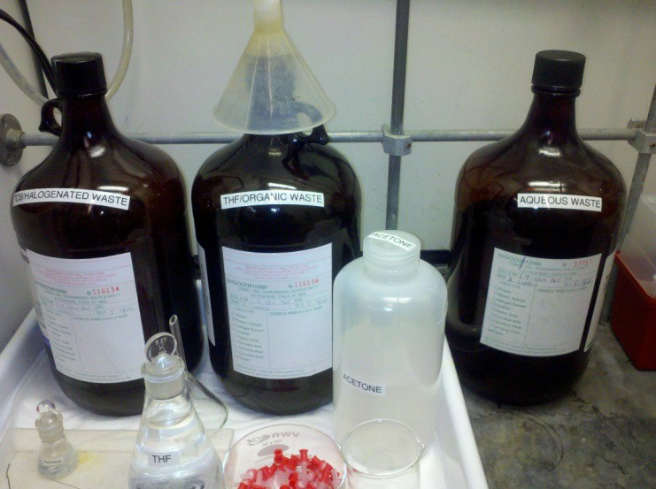
Chemical Waste
Waste containers are provided in the hood to accommodate GPC sample waste (TCB/”Halogenated Waste”, and THF/”Organic Waste”). Your GPC sample vials should be emptied into one of these two containers and rinsed with acetone before being disposed of in the glass waste container provided.
Vial caps should be discarded into the TRASH CAN and NOT THE GLASS WASTE CONTAINER!
“Other” organic waste and solvents should be disposed of in the container labeled “Organic Waste”. A list of popular solvents and reagents is provided and is attached to the bottle. Please check off the one(s) you add to the container. If it is not on the list, please write it in.
Aqueous waste (most likely from the aqueous GPC) can be added to the waste container labeled “Aqueous Waste” in the hood.
If the container is full, please let the Facility Manager know so that it can be emptied and replaced with a new container.
Be sure your liquid chemical waste and excess solvent(s) ends up in one of these three bottles!

Slide 12
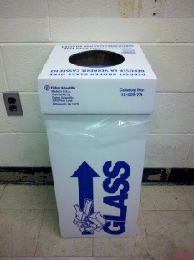
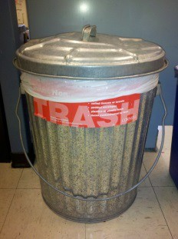
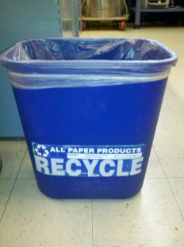
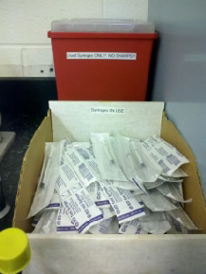
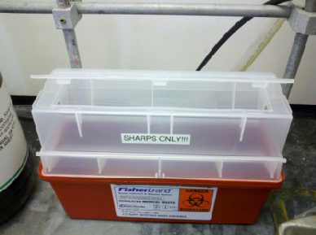
Glass Waste, Sharps Disposal, Trash, and Recycling
Disposable or broken glass, used pipette tips. No sharps, gloves, paper, etc.
Solid waste, gloves, vial caps. No sharps, paper, liquids, etc.
Recycleable paper products ONLY!
Disposable 1 cc syringes and 0.45 μ filters are provided for GPC sample filtration. Used syringe barrels and filters can go into the container by the sink.
Sharps used FOR ANY REASON should go into the “Sharps Only” disposal container, located in the back of the hood This includes syringe needles (not available in the Facility), razor blades, X-Acto knives, etc.

Slide 13
Shared Facility Access
All users must understand the information presented in this facility orientation and show proof of the following safety trainings, available through Workday Learning, in order to gain access to the facility:
EH&S Laboratory Safety (#2555-laboratory)
EH&S Chemical Waste Disposal (#2716-chemwaste)
EH&S Fire Safety (#5330-firesafety)
See http://workday.cornell.edu/ for information on how to obtain training or verify your records

Slide 14
The CCMR reminds researchers preparing to publish results to consider journal guidelines for determining co-authorship. This generally includes substantial/significant contributions to experiment design, data acquisition, analysis and interpretation. Determination of co-authorship depends on the contribution of the individual and should be made without regard to position or compensation.
All co-authors must approve manuscript versions for publication and agree to be held accountable for the work.
CCMR Facility Policies
Using CCMR FOM and CCMR instrumentation:
To use a particular instrument, a researcher is required to have been trained by facility staff unless specifically posted otherwise. An unauthorized researcher and anyone knowingly granting access to such person is in violation.
Users are not allowed to share login IDs/passwords, or to reserve or enable an instrument on behalf of another user.
Instrumentation must be reserved and enabled by the intended user prior to and during use.
Disabling or circumventing instrument interlocks for the purpose of avoiding instrument permissions or machine time charges is strictly forbidden.
Users are not to move or disturb the work of other researchers unless given permission by facility staff or the researcher. Notify facility staff about unattended samples.
Users are expected to remove all samples and to leave the work area in as dean or cleaner condition compared to when they arrived.

Slide 15
CCMR Facility Access Form
Please go to the link below to download the pdf form which you can provide to the appropriate facility staff
http://www.ccmr.cornell.edu/ccmraccessform/

